Slide 1
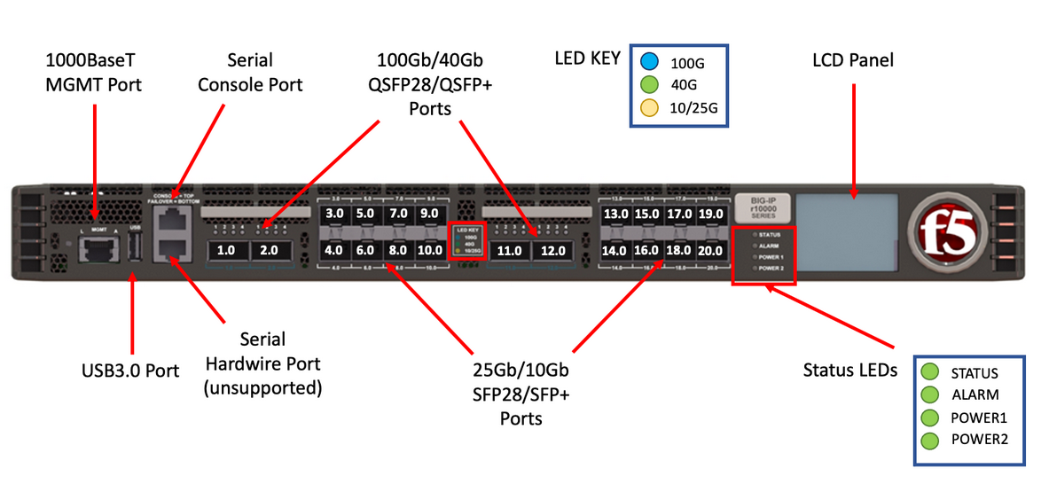
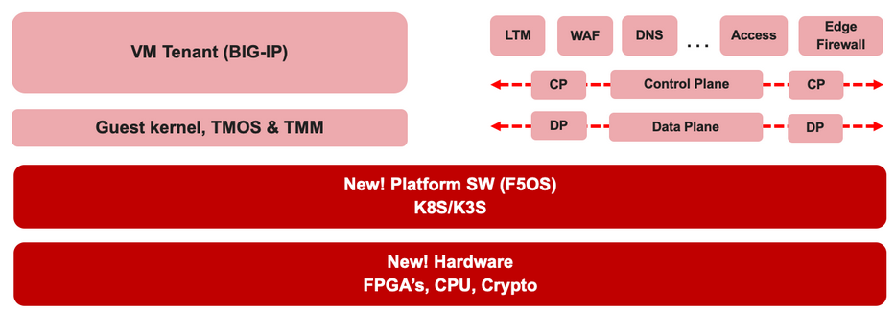

F5 rSeries Learning with Alexander S

Slide 2
Agenda →
iSeries to rSeries
F5OS Basic Setup
F5OS Upgrade Procedure
VLAN and LAG Configuration
Configure VLANs
Configure LAG (Link Aggregation Group)
Assign VLANs to the LAG
Tenant OS Deployment Preparation
Tenant OS Deployment
rSeries Tenant Basic Setup
High Availability (HA) in rSeries Tenants
Best Practices for rSeries Tenant HA
rSeries Tenant HA Configuration

Slide 3
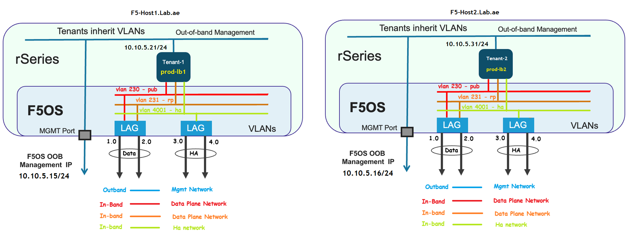
Chapter 6 – Tenant OS deployment

Slide 4
Chapter 6 – Tenant OS deployment This video is a continuation of Chapter 05.

Slide 5
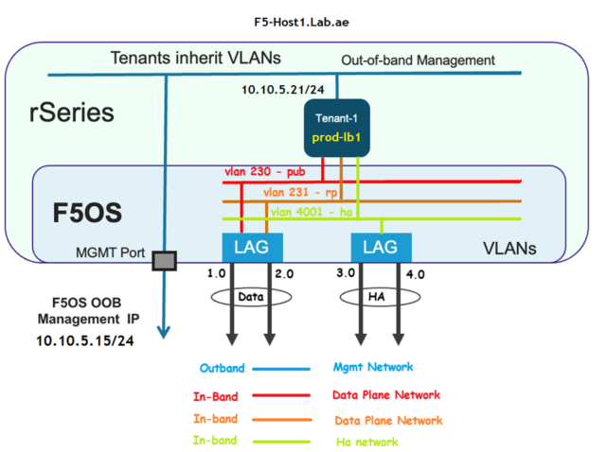
Chapter 6 – Tenant OS deployment F5-Host1.Lab.ae – Tenent01 deployment details
Tenant name – prod-lb1
Tenant type – Bigip
Tenant image – TMOS-17.1.2.2
Mgmt IP – 10.10.5.21/24
Mgmt Gw – 10.10.5.1
Vlans assignment
Data Vlan – 230 & 231
Ha vlan – 4001
MAC block Size – Large
Resource Provisioning – Go with recommended
& Select 4vCPU
Disk Size – Allocate 160GB
Initial state – Configured
Middle state – Provisioned
End state – Deployed
Crypto Acceleration – Enabled
Appliance mode – Disabled

Slide 6
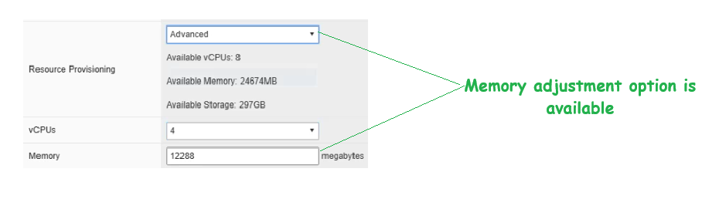
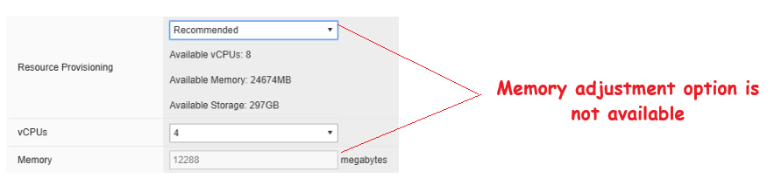
Chapter 6 – Tenant OS deployment Tenent01 deployment details – Advanced mode
Advanced mode
For production environments, Advanced Mode is recommended.
This mode provides flexibility to adjust DRAM allocation based on the modules installed (such as LTM, ASM, or APM).
Recommended Mode
Such customization is not possible in Recommended Mode.

Slide 7
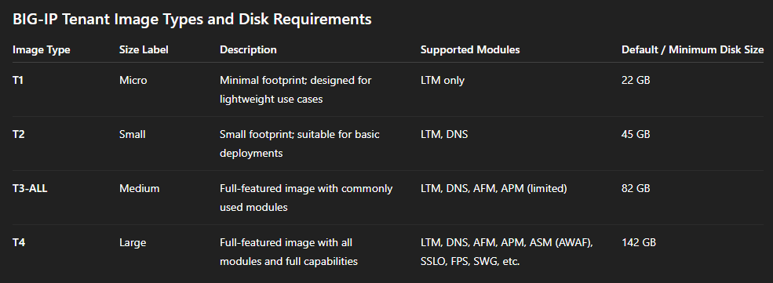
Chapter 6 – Tenant OS deployment Tenant deployment details – Disk image size
Four types of BIG-IP tenant images available for rSeries.
Each image type has different system resource requirements and supports different sets of modules.

Slide 8
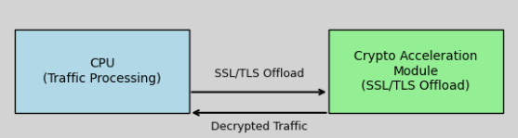
Chapter 6 – Tenant OS deployment Tenant deployment details – Crypto Acceleration
To offload SSL/TLS task to rSeries Crypto Accelerator hardware

Slide 9





Chapter 5 – Tenant OS deployment Preparation 6. Understanding and Changing Tenant Deployment State
Tenant’s settings and parameters are defined and saved in the F5OS
Configured
Provisioned
Deployed
No resources allocated
Only for the initial deployment
Settings & Parameters
System resources such as vCPU, memory, and disk space are allocated to the tenant.
Tenant is not active!
CPU, DRAM and HDD assigned
CPU, DRAM and HDD assigned
The tenant is active and running. It is utilizing the allocated CPU, memory, and virtual disk to perform its intended functions.
System is active

Slide 10

Chapter 5 – Tenant OS deployment Preparation 6. Understanding configured to provisoned
Tenant’s settings and parameters are defined and saved in the F5OS
No resources allocated
Configured
Provisioned
Only for the initial deployment
Settings & Parameters
Provisioning
System resources such as vCPU, memory, and disk space are allocated to the tenant.
Tenant is not active!
CPU, DRAM and HDD assigned

Slide 11
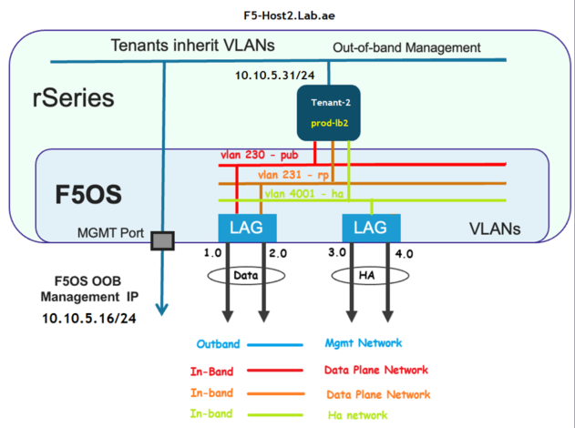
Chapter 6 – Tenant OS deployment F5-Host2.Lab.ae – Tenent02 deployment details
Tenant name – prod-lb2
Tenant type – Bigip
Tenant image – TMOS-17.1.2.2
Mgmt IP – 10.10.5.31/24
Mgmt Gw – 10.10.5.1
Vlans assignment
Data Vlan – 230 & 231
Ha vlan – 4001
MAC block Size – Large
Resource Provisioning – Go with recommended
& Select 4vCPU
Disk Size – Allocate 160GB
Initial state – Configured
Middle state – Provisioned
End state – Deployed
Crypto Acceleration – Enabled
Appliance mode – Disabled

Slide 12
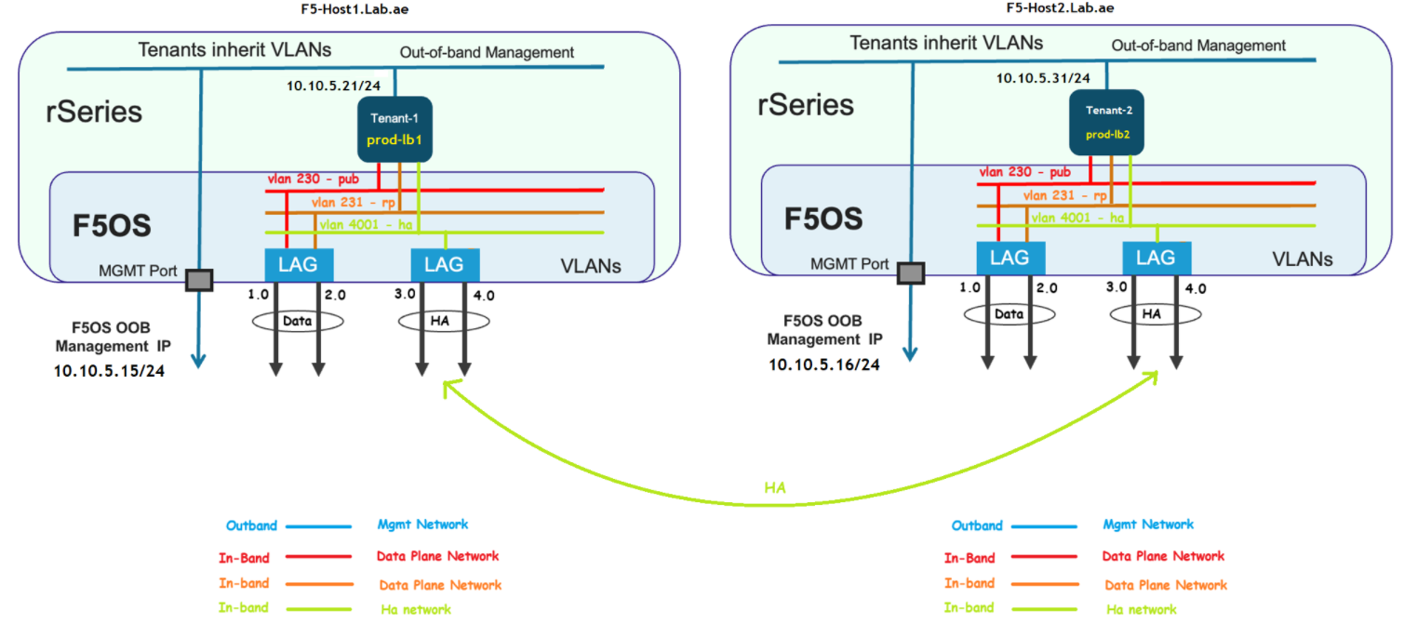
Chapter 6 – Tenant OS deployment High availability between the tenant01 & tenant02

Slide 13
Chapter 6 – Tenant OS deployment F5-Host2.Lab.ae – Tenent02 deployment details
Tenant name – prod-lb2
Tenant type – Bigip
Tenant image – TMOS-17.1.2.2
Mgmt IP – 10.10.5.31/24
Mgmt Gw – 10.10.5.1
Vlans assignment
Data Vlan – 230 & 231
Ha vlan – 4001
MAC block Size – Large
Resource Provisioning – Go with recommended
& Select 4vCPU
Disk Size – Allocate 160GB
Initial state – Configured
Middle state – Provisioned
End state – Deployed
Crypto Acceleration – Enabled
Appliance mode – Disabled

Slide 14
Please continue by watching the next video. Next video is – rSeries Tenant Basic Setup – Thank you!!!
Chapter 6 – Tenant OS deployment successfully done!!!

